Slide 1

Heart Disease Predictions using Supervised Learning

Slide 2

About Peterside Hospital
Peterside Hospital is a private hospital located in Lagos, Nigeria. It was founded in 2000 by Dr. Efemena Ikpro, a renowned Nigerian physician. The hospital provides a wide range of medical services, including general medicine, surgery, paediatrics, obstetrics and gynaecology, cardiology, neurology, and oncology.
Peterside Hospital is known for its state-of-the-art facilities, modern equipment, and highly skilled medical professionals. The hospital has a team of over 300 medical personnel, including doctors, nurses, and other healthcare professionals, who are trained locally and internationally.
The hospital has several specialized clinics, including a diabetes clinic, a fertility clinic, a heart clinic, and a cancer clinic. It also offers services such as health check-ups, laboratory tests, and imaging services.

Slide 3

Objective:
To build a machine-learning model that can predict the likelihood of a person having a heart disease based on the given features.

Slide 4
Features in the dataset and meaning
The heart CSV dataset contains 303 records and 14 columns, including the target variable
+ age- in years
+ sex-(1 = male, 0=female)
+ cp-chest pain type (1: typical angina 2: atypical angina, 3: non-anginal pain, 4: asymptomatic),
+ trestbps - resting blood pressure (in mm Hg on admission to the hospital),
+ chol - serum choestoral in mg/dl,
+ fbs- (fasting blood sugar > 120 mg/dl) (1 =true; 0 =false),
+ restecg - resting electrocardiographic results,
+ thalach-maximum heart rate achieved,
+ exang - exercise induced angina (1 = yes; 0= no),
+ oldpeak - ST depression Induced by exercise realve to rest,
+ slope-the sope of the peak exercise ST segment,
+ ca-number of major vessels (0-3) colored by flourosopy,
+ thal -3 = normal; 6 = fixed defect; 7 = reversable defect,
+ target-have disease of not (1=yes, 0=no).

Slide 5
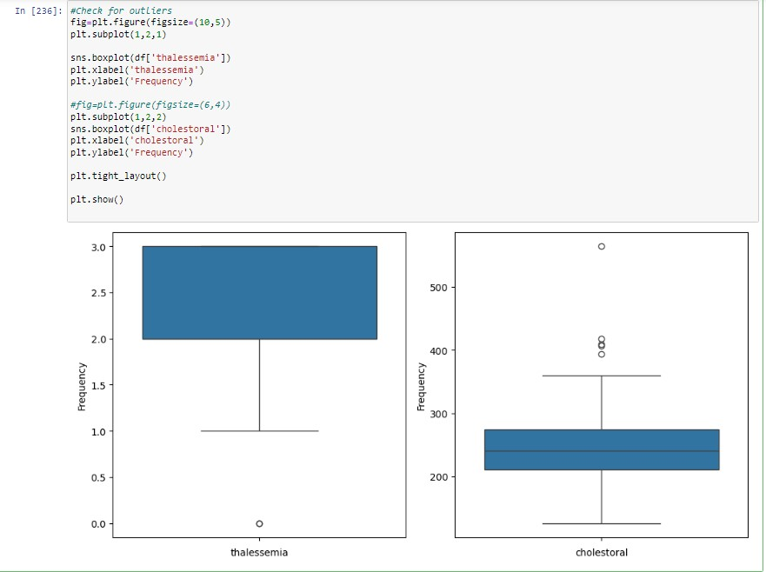
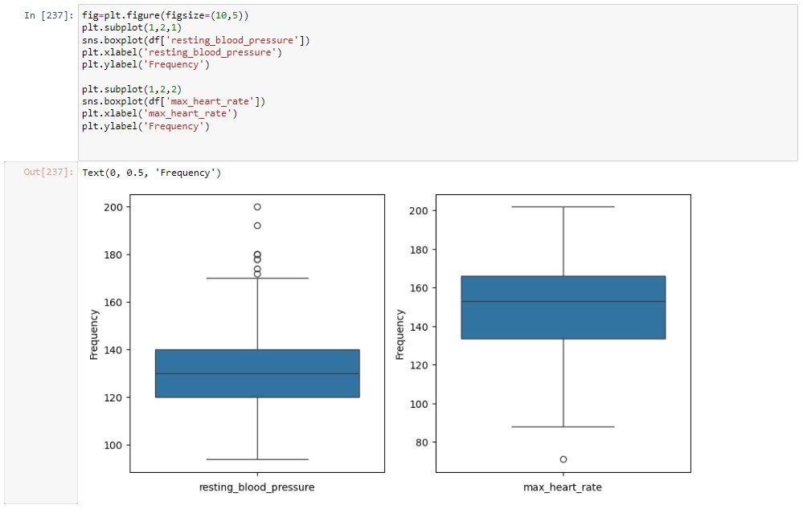
Exploratory Data Analysis Univariate analysis
univariate analysis serves as a foundational step in the statistical exploration of data. It provides crucial insights into the characteristics of individual variables. Here, the boxplot indicates that there are outliers in these features that need to be normalized.

Slide 6
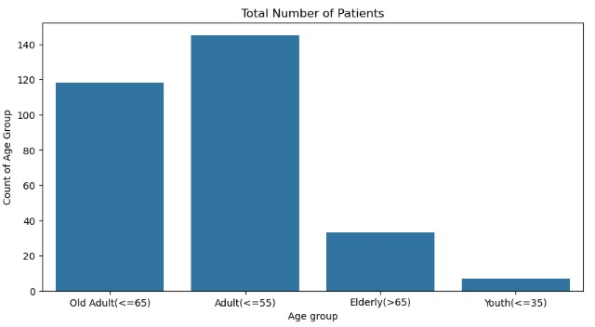
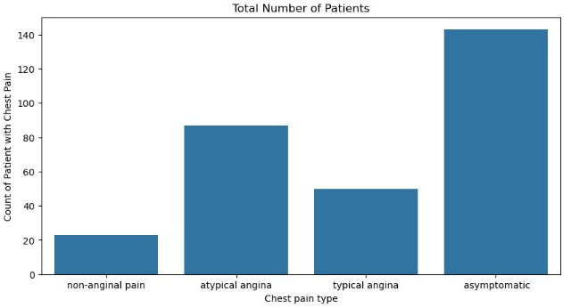
Exploratory Data Analysis Univariate analysis
The data suggests a progressive increase in susceptibility to heart disease with age, with the Elderly (>65) group showing a relatively higher vulnerability. Tailored preventive measures and regular health screenings may be particularly crucial for patients in the Adult (<=55) and Old Adult (<=65) categories, given their significant representation in the data. The relatively lower number of cases in the Youth (<=35) group does not imply immunity. Early intervention strategies and health education can play a vital role in reducing risks even in this age bracket
. The data suggests a significant number of patients presenting with asymptomatic chest pain, highlighting the need for comprehensive screening and diagnostic methods to detect potential heart issues in the absence of apparent symptoms. Atypical angina cases underscore the importance of considering less typical symptoms during diagnostic procedures to ensure a more inclusive and accurate assessment. Patients exhibiting typical angina symptoms may require immediate attention and monitoring due to the clear association with heart-related issues. Non-anginal pain cases may require a more detailed investigation to identify and address alternative causes for their symptoms.

Slide 7
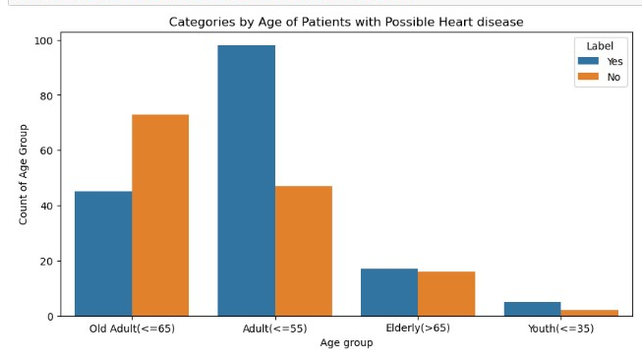
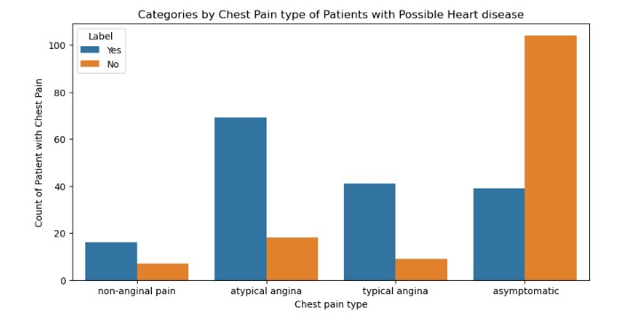
Exploratory Data Analysis Bivariate analysis
The graph shows that Adults between 36 and 55 years of age are the group with the hoghest rosk of develoing a heart illness. However, the youth category are alos a subject of concern because although they have the least chance of developing a heart disease,the number of potentially positive cases is higher than the number of potentially negative cases. This means that they do not seem to be of significant threat because they are being compared with a more visible majority.
The graph shows tallies with the result from the univariate analysis that was carried out earlier which shows that a significant majority of the population display asymptomatic Chest Pain

Slide 8
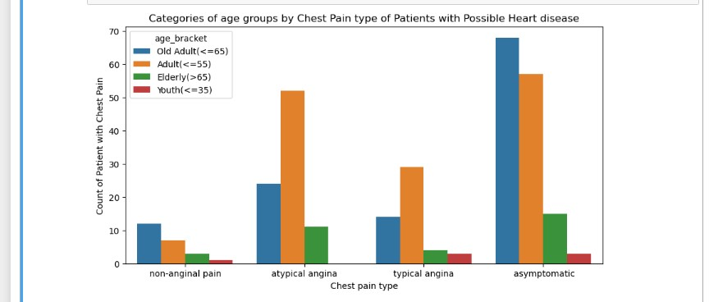
Exploratory Data Analysis Bivariate analysis
A further analysis tells us that within the asymptomatic category, adults between the ages of 56 to 65 display the highest case of asymptomatic chest pain. We can also see that typical angina is frequent in patients from 36 to 55 years of age and finally, that the youth have a relatively less frequency of occurrence across the board.

Slide 9
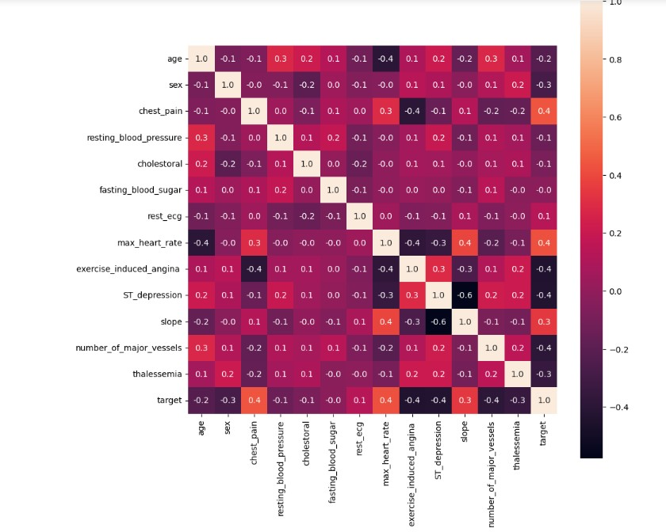
Exploratory Data Analysis Multivariate Analysis
In this correlation chart, a significant relationship to the target is what is what is most desired in order to establish a strong correlation. A proper correlation would be identified between +o and +1 and that is shown across the correlation map. Relative to the target, we can see that the Chest Pain Type, Maximum Heart Rate achieved and the slope have significant correlations. Hence, they can be regarded as valuable markers for predicting heart diesease.
All other features may not be direct causes of heart disease as they have negative relationships.

Slide 10
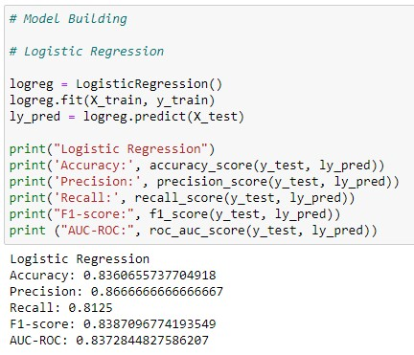
Data Preprocessing/ML Model building and training
In the implemented a machine learning algorithm, specifically Logistic Regression, to predict the likelihood of patients contracting heart disease. The algorithm, having undergone training on relevant medical data, demonstrated commendable performance, as evidenced by the following evaluation metrics:
Accuracy: 83.61% The model achieved a high level of accuracy in predicting whether a patient is at risk of heart disease. This indicates the proportion of correct predictions among the total predictions made by the algorithm.
Precision: 86.67% Precision measures the accuracy of positive predictions, indicating the percentage of predicted positive cases that are truly positive. In this case, the algorithm exhibited a robust ability to accurately identify patients with a high chance of contracting heart disease.
Recall: 81.25% Recall, also known as sensitivity or true positive rate, measures the ability of the model to identify all relevant instances. In the context of heart disease prediction, this reflects the algorithm's effectiveness in capturing a significant proportion of patients who are actually at risk.
F1-score: 83.87% The F1-score is the harmonic mean of precision and recall, providing a balanced assessment of the model's overall performance. A higher F1-score indicates a well-balanced trade-off between precision and recall, showcasing the algorithm's reliability in identifying individuals with a high probability of heart disease.
AUC-ROC: 83.73% The Area Under the Receiver Operating Characteristic (AUC-ROC) curve is a key metric for assessing the model's ability to discriminate between positive and negative instances. The achieved AUC-ROC value demonstrates a strong performance in distinguishing patients with and without a high likelihood of heart disease.
In summary, the Logistic Regression algorithm employed by Hospital Peterside exhibited promising results, providing a valuable tool for identifying individuals at risk of heart disease. These metrics collectively underscore the model's accuracy, precision, recall, F1-score, and discriminatory power, validating its potential to contribute significantly to proactive healthcare interventions and patient well-being.

Slide 11
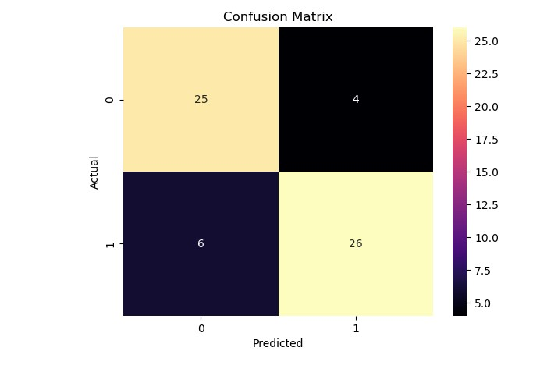
Machine Learning Model Evaluation
True Positive (TP): 25
These are cases where the model correctly predicted that patients have a high chance of contracting heart disease. In the context of patient care, this is a crucial outcome, as it enables proactive intervention for individuals at risk.
False Positive (FP): 4
Unfortunately, in four instances, the model wrongly predicted a high chance of heart disease when, in reality, the patients did not have such a risk. While false positives can lead to unnecessary concerns, they also highlight areas for refinement in the model to reduce over-predictions.
True Negative (TN): 26
This category represents cases where the model accurately predicted that patients do not have a high chance of contracting heart disease. This is a favorable outcome as it ensures that individuals without the risk are not unnecessarily subjected to further medical assessments or treatments.
False Negative (FN): 4
Four cases were instances where the model failed to predict a high chance of heart disease when, in fact, the patients did have such a risk. False negatives are critical to address as they involve missing potential cases that require medical attention. This emphasizes the importance of improving sensitivity in the model.
In summary, the Confusion Matrix for Hospital Peterside's heart disease prediction model provides a nuanced understanding of its strengths and areas for improvement. While the model demonstrates high specificity (TN rate) and positive predictive value (TP rate), efforts should be directed towards reducing false positives and false negatives to enhance overall accuracy and ensure timely intervention for at-risk patients. Continuous refinement of the machine learning algorithm, based on insights from the Confusion Matrix, will contribute to more reliable predictions and improved patient outcomes.

Slide 12
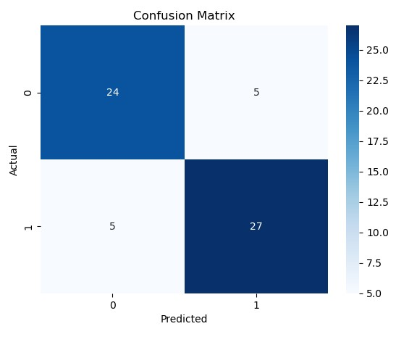
Machine Learning Model Evaluation
The True Positive count stands at 24, indicating that the algorithm correctly identified 24 individuals who truly had a high chance of developing heart disease. This is a crucial metric, showcasing the model's ability to accurately detect positive cases.
Conversely, the False Positive count is noted at 5, signifying instances where the algorithm incorrectly predicted a high chance of heart disease. While these cases represent false alarms, they also underscore the importance of further refinement to minimize unnecessary concerns for patients.
The True Negative count, at 27, reveals the algorithm's proficiency in correctly identifying individuals with a low risk of contracting heart disease. This is a key aspect of the model's accuracy, as it ensures that those not at risk are appropriately classified.
Finally, the False Negative count is reported at 5, denoting cases where the algorithm failed to identify individuals who, in reality, had a high chance of developing heart disease. Addressing these instances is crucial for improving the algorithm's sensitivity and preventing potential oversights in patient risk assessment.
In summary, the confusion matrix for Peterside Hospital's machine learning algorithm provides a nuanced understanding of its predictive performance. The focus moving forward should involve optimizing the model to enhance both sensitivity and specificity, ensuring a more reliable and effective tool for identifying patients at risk of heart disease. This continuous refinement process will contribute to Peterside Hospital's commitment to delivering advanced and accurate healthcare solutions to its patients

Slide 13
Conclusions
The analysis covered precision, recall, and ROC scores for each algorithm. The following provides a detailed breakdown and recommendations based on these metrics:
Precision Score Analysis:
Decision Tree (92.59%): The Decision Tree classifier demonstrated the highest precision, showcasing exceptional accuracy in identifying patients at risk of heart disease. This model is highly recommended for its reliability.
Naive Bayes (90.0%): With a high precision score, Naive Bayes is a valuable and efficient model for identifying potential heart disease cases. Its simplicity adds to its appeal.
Random Forest (86.67%) and Logistic Regression (86.67%): Both Random Forest and Logistic Regression models displayed balanced precision scores, providing a reliable compromise between accuracy and interpretability.
XGB Classifier (86.21%): The XGB Classifier exhibited a respectable precision score, making it a robust choice for heart disease prediction due to its ensemble learning approach.
K-Nearest Neighbours (79.31%): While slightly lower in precision, K-Nearest Neighbours still offers reasonable performance. Further optimization may enhance accuracy.
SGD Classifier (72.09%) and SVC (65.71%): These models exhibited lower precision scores, indicating they may not be the most suitable for this task. Fine-tuning and feature engineering may be necessary for improved performance.
pplications.

Slide 14
Machine Learning Model Evaluation
Recommendations:
Prioritize models with higher precision, such as Decision Tree, Naive Bayes, Random Forest, and Logistic Regression.
Continuous monitoring and fine-tuning are crucial for optimal performance and improved patient care.
Recall Score Analysis:
SGD Classifier (96.88%): Stands out with the highest recall score, making it exceptional in correctly identifying patients at risk of heart disease. Recommended for its sensitivity.
Naive Bayes (84.38%) and Random Forest (81.25%): Demonstrated robust performance in identifying high-risk patients, making them strong candidates for deployment.
Logistic Regression and XGB Classifier (81.25%): Exhibited competitive recall scores, showcasing efficacy in capturing true positive cases.
Decision Tree and XGB Classifier (78.12%): Reliable but with slightly lower sensitivity compared to top-performing models.
K-Nearest Neighbours and SVC (71.88%): Effective but may benefit from further optimization to enhance sensitivity.
Recommendations:
SGD Classifier is recommended for its outstanding recall score.
Consider models like Naive Bayes and Random Forest for deployment.
Continuous monitoring and updates are advised for evolving patient data and improved performance.
ROC Score Analysis:
Naive Bayes (87.02%): Achieved the highest ROC score, indicating strong discriminatory power in identifying individuals at risk of heart disease.
Random Forest, Decision Tree, and Logistic Regression (83.73%, 85.61%, 83.73%): Demonstrated robust performance, offering a balance between performance and interpretability.
XGB Classifier (82.17%): Performed well, showcasing its effectiveness in this context.
K-Nearest Neighbours and SGD Classifier (75.59%, 77.75%): Exhibited slightly lower ROC scores.
SVC (65.25%): Recorded the lowest ROC score, suggesting relatively lower discriminatory ability.
Recommendations:
Naive Bayes appears promising for heart disease prediction.
Random Forest, Decision Tree, and Logistic Regression are strong candidates.
Reassess K-Nearest Neighbours, SGD Classifier, and SVC for potential optimizations or alternative algorithms.

Slide 15
Machine Learning Model Evaluation
Conclusion: The evaluation of machine learning models for heart disease prediction at Peterside Hospital indicates promising results. The choice of the most suitable algorithm should consider a balance between precision, recall, ROC score, interpretability, and potential clinical implications. Continuous fine-tuning, validation, and adaptation to new data are recommended for optimal performance in real-world healthcare applications.

